Slide 1
UNIVERSITY OF WISCONSIN–MADISON
Voice Over Internet Protocol (VoIP)
Info Session

Slide 2
01 | Introductions
02 | VoIP Project Background
03 | What, Why, and When
04 | Hardware (Hard) choices
05 | Software (Soft)
06 | Key Changes
07 | Transition Process
08 | When Cisco VoIP Goes Live
09 | Resources and Documentation
10 | Questions

Slide 3
Introductions
Ken Fanta, Project Manager for SMPH and IS Director Dept. of Orthopedics and Rehabilitation
Manda Johnson, Service Delivery Lead, DoIT Network Applications

Slide 4
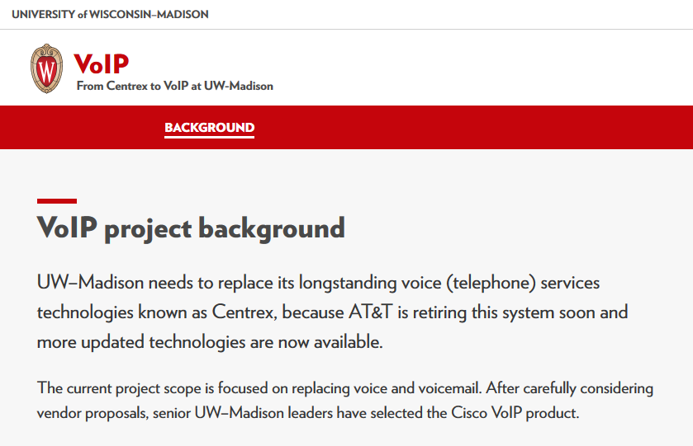
VoIP website: https://voip.it.wisc.edu/
Notes:
AT&T is retiring the Centrex system in the year 2020, per Eric Alborn
Show the VoIP website to audience, Timeline and schedule (link for Project Calendar), FAQ’s, Where to find Help—links to KnowledgeBase

Slide 5
What?
Voice over Internet Protocol (VoIP) uses a combination of the campus network, the global internet system, and traditional telephone company access to the Public Switched Telephone Network (PSTN) to place and receive local and long distance calls.
Departments will have choice of replacing existing telephone with Cisco VoIP hard phone and/or using a “soft client” as an application on your computer with a headset.
Campus leadership has chosen Cisco VoIP technology and CDW as its reseller and integrator.
Campus Leadership has chosen to implement Cisco Unified Communications
Notes:
A phone that works over the internet, along with UW network, and AT&T.
“Soft client” is software (Cisco Jabber) that is installed on your computer and is used with a headset
KB doc for Cisco Jabber Overview (including links for navigation and answering/placing calls) is doc #72533.
Local vendor/Cisco reseller is CDW (Charlie, Delta, Whiskey) located in Fitchburg on the SW side of Madison

Slide 6
Why?
The original State of Wisconsin contract for AT&T Centrex (analog and ISDN, Integrated Services Digital Network) telephone service has ended. The contract extension includes price increases intended to motivate State agencies to move to new technology.
When will we finish?
The plan is for the whole campus to be converted by June of 2018
Notes:
UW-Madison is paying higher rates for AT&T Centrex telephone service.

Slide 7
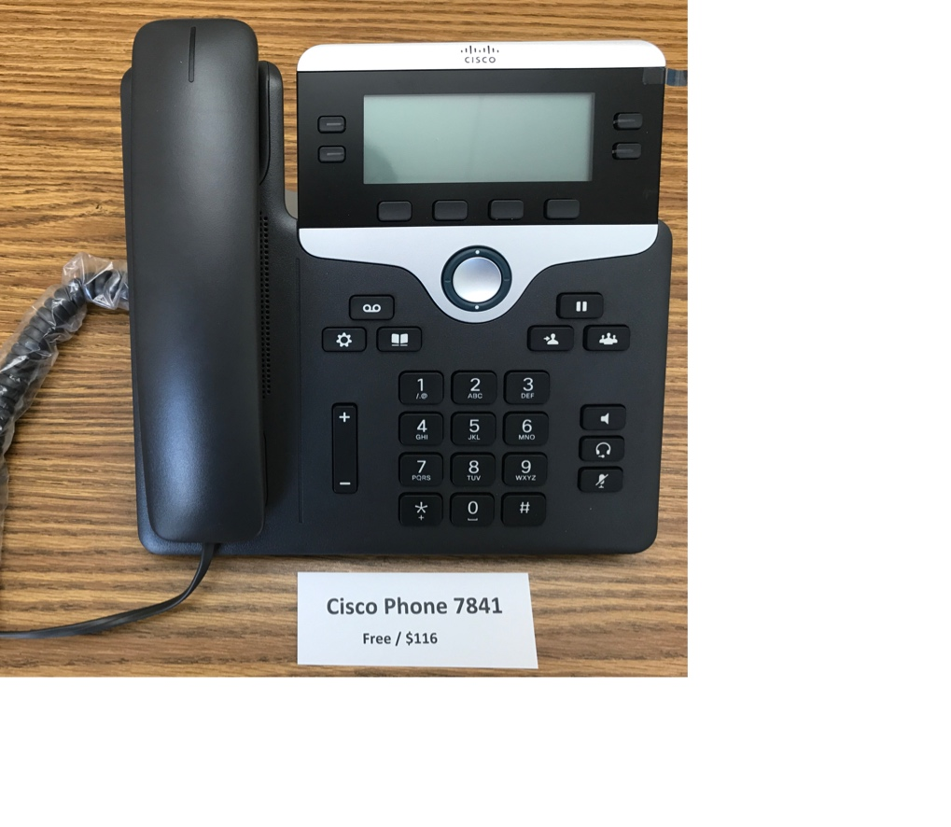
Equipment Choices:
Cisco Phone 7841
Hard phone option 1
Cost: Free or $116
Display is White backlite, greyscale
Tri-color LED on line keys
Up to 4 phone numbers (lines) displayed

Slide 8
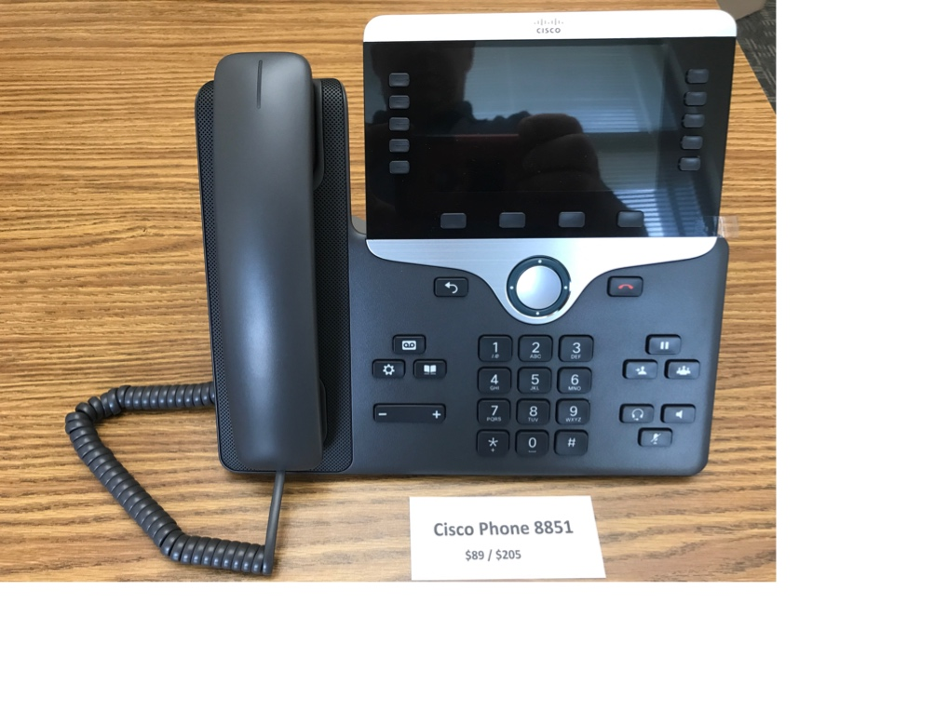
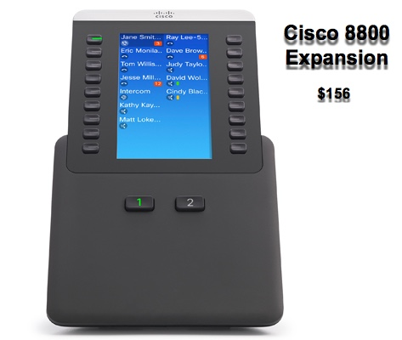
Cisco Phone 8851
Hard phone option 2
Equipment Choices:
Cost: $89 or $205
Display is 5” 24 bit color 800x480
Tri-color LED on line keys
Up to 10 phone numbers (lines) displayed
Side USB port for wired or wireless headsets
Bluetooth 3.0
RJ-9 analog headset jack
Cisco Phone 8800 Exp.
Hard phone option 2 expansion
Cost: $156
Color LCD
Tri-color LED on line keys (green steady - in use, red steady – in use by shared line, amber flashing – line ringing
Works only with Cisco 8851 Phone
Adds 18 additional keys plus a second page for a total of 36 additional keys to assign phone numbers or dialing shortcuts to.

Slide 9
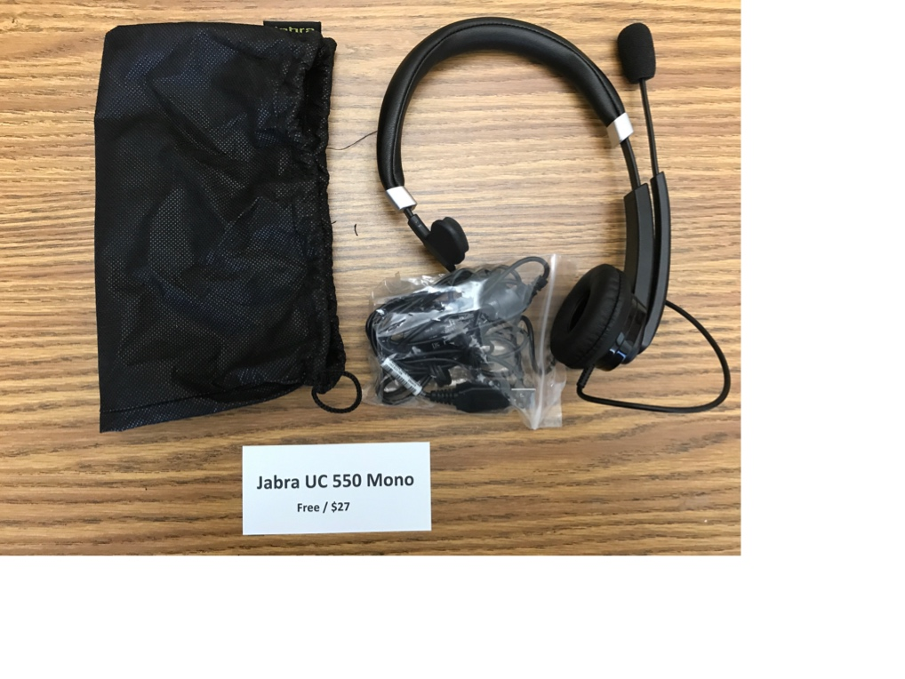
Equipment Choices:
Jabra UC 550 Mono
Soft phone option 1
Cost: Free or $27
Designed for light to medium use
PC via USB cable
IP phone via USB cable
Suitable for quiet environments

Slide 10
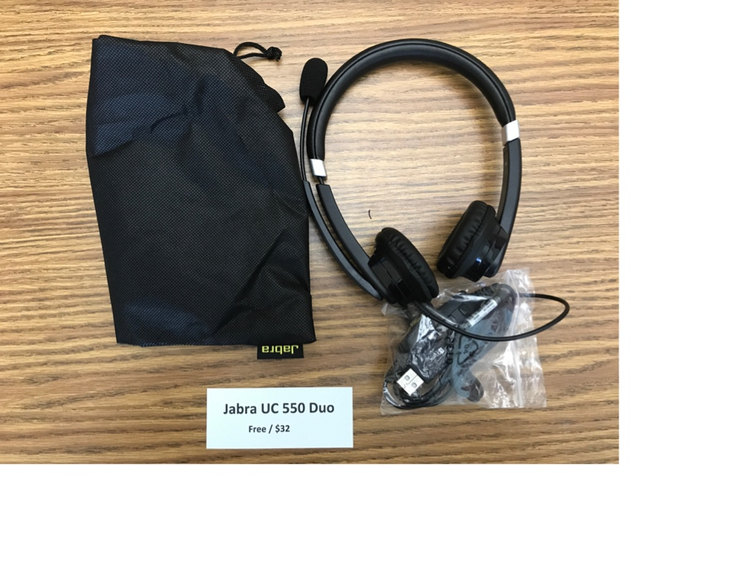
Equipment Choices:
Jabra UC 550 Duo
Soft phone option 2
Cost: Free or $32
Designed for light to medium use
PC via USB cable
IP phone via USB cable
Suitable for nosier environments

Slide 11
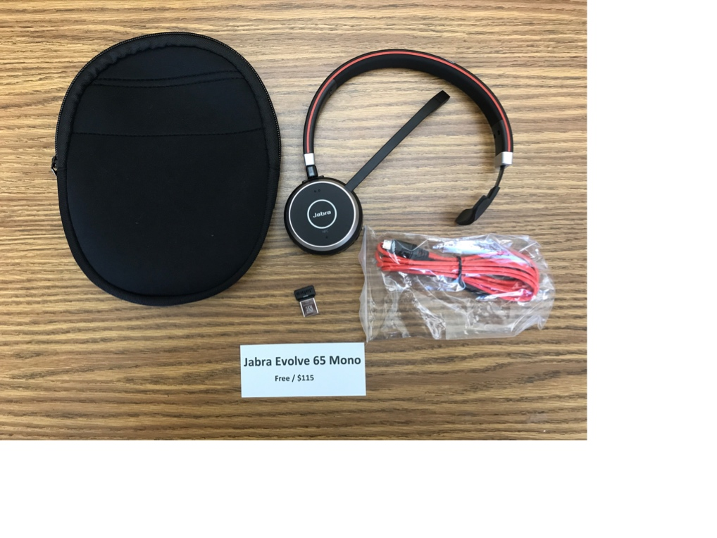
Equipment Choices:
Jabra Evolve 65 Mono
Soft phone option 3
Cost: Free or $115
Designed for music for voice
100 feet wireless range
10 hours talk time
Tap to connect
Passive noise cancellation
Busy light
USB cable to connect to PC or for Charging
Use the Jabra Link 360 Dongle for wireless

Slide 12
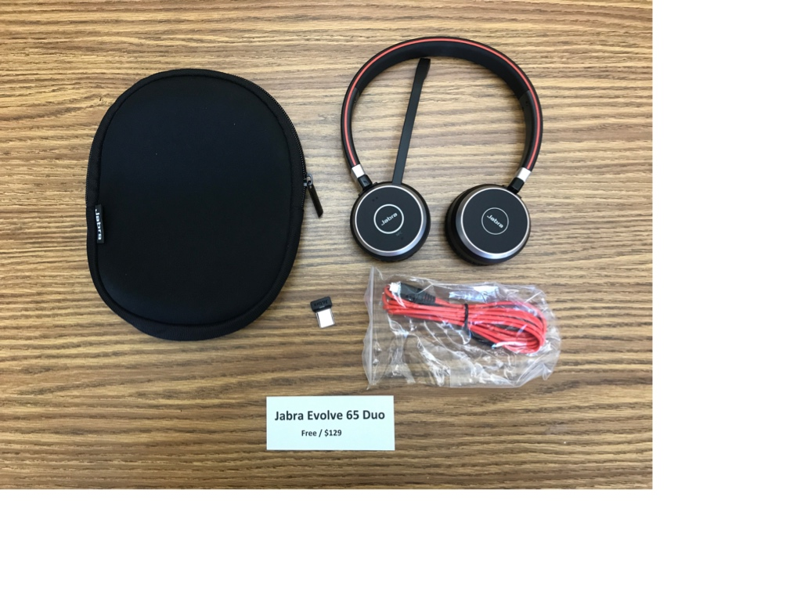
Equipment Choices:
Jabra Evolve 65 Duo
Soft phone option 4
Cost: Free or $129
Designed for music for voice
100 feet wireless range
10 hours talk time
Tap to connect
Passive noise cancellation
Busy light
USB cable to connect to PC or for Charging
Use the Jabra Link 360 Dongle for wireless

Slide 13
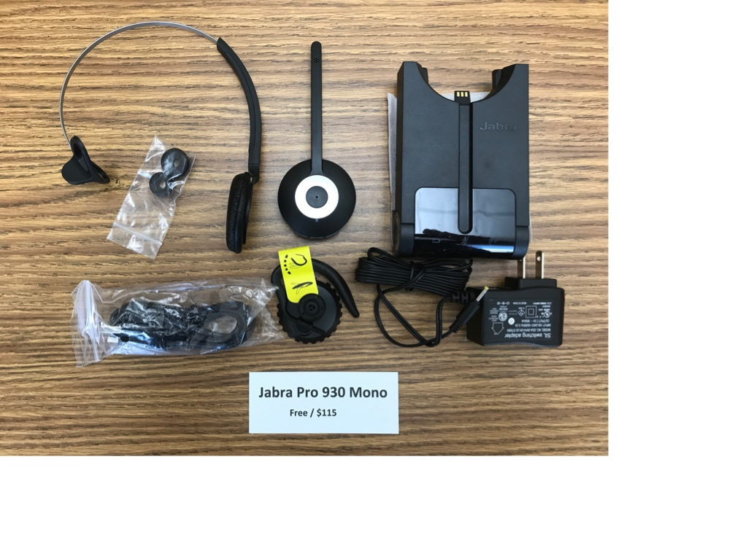
Equipment Choices:
Jabra Pro 930 Mono
Soft phone option 5
Cost: Free or $115
Designed for voice
120 feet wireless range
8 hours battery life
Tap to connect
Noise cancelling microphone
Dual connectivity (connect to 2 BT devices)
Ringing base/charging base

Slide 14
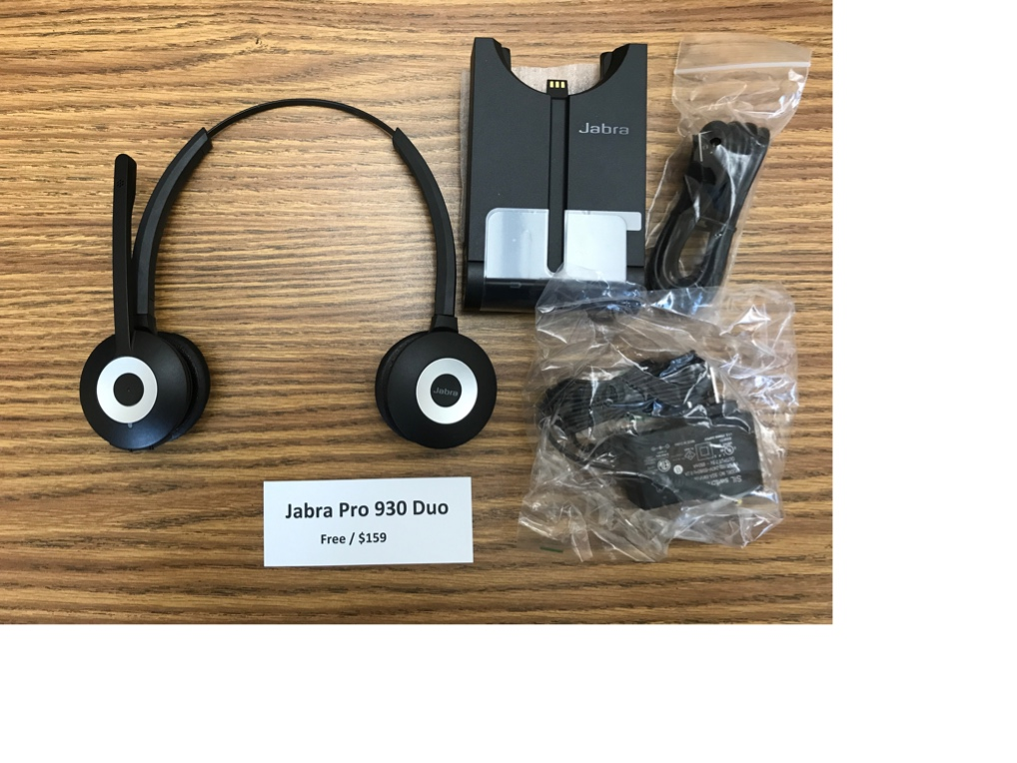
Equipment Choices:
Jabra Pro 930 Duo
Soft phone option 6
Cost: Free or $159
Designed for voice
120 feet wireless range
8 hours battery life
Tap to connect
Noise cancelling microphone
Dual connectivity (connect to 2 BT devices)
Ringing base/charging base

Slide 15
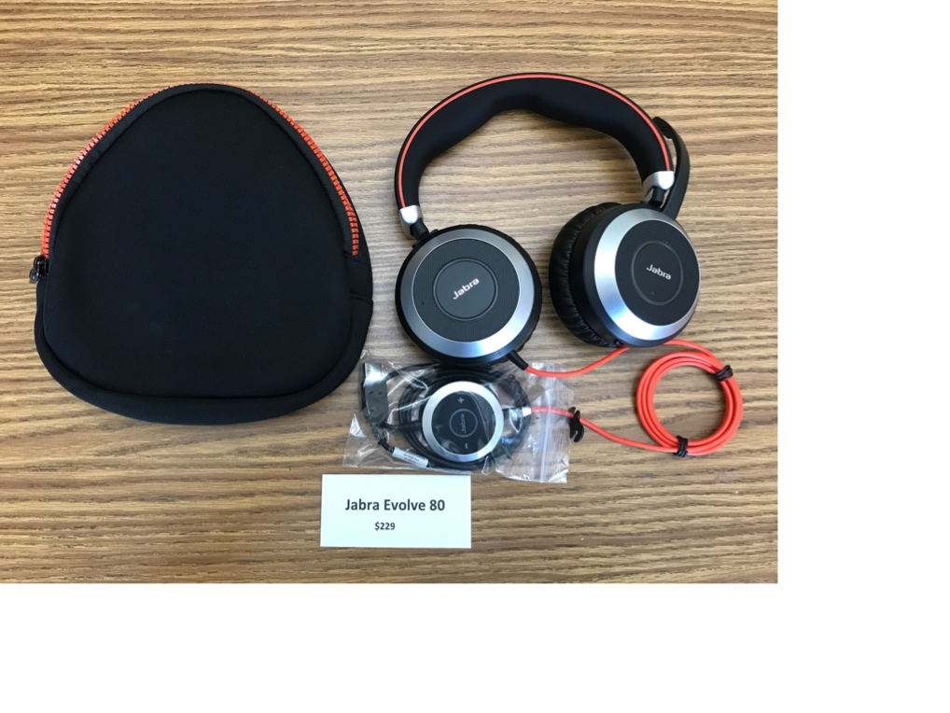
Equipment Choices:
Jabra Evolve 80
Soft phone option 7
Cost: $229
Designed for voice and music
Active noise cancellation
Integrated busy light
Listen in function
Microphone mute when boom is up
Easy call management via control unit

Slide 16
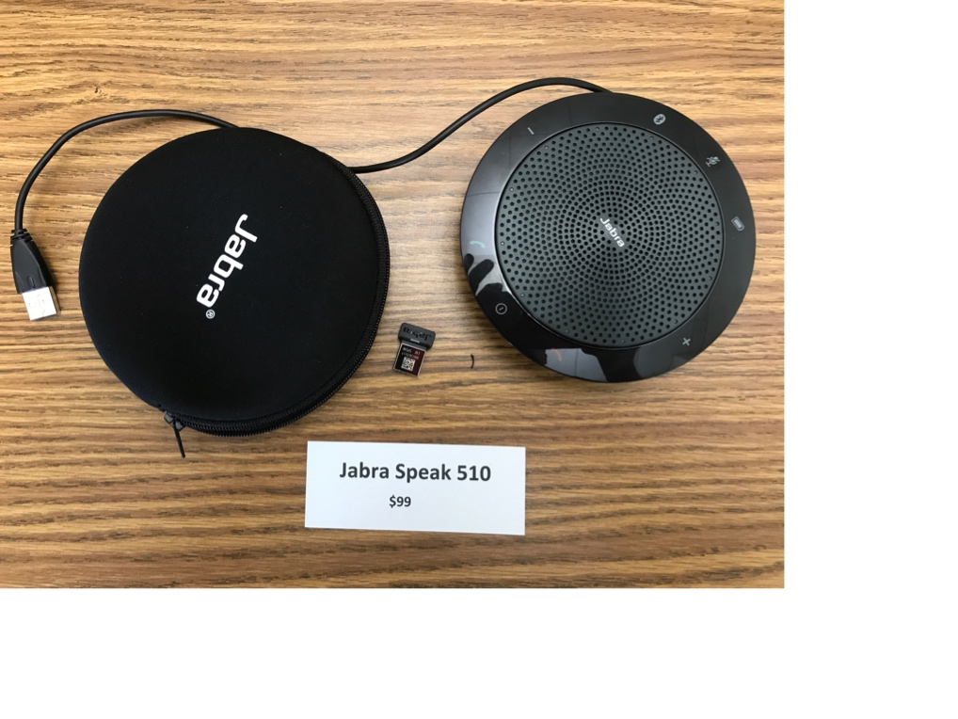
Equipment Choices:
Jabra Speak 510
Conference Phone Option 1
Cost: $99
Designed for use in small rooms with smaller groups of people
Recommended for groups up to 4 people
Up to 15 hours of talk time
USB or Bluetooth connectivity
Connect to PC, Smartphone or Tablet

Slide 17
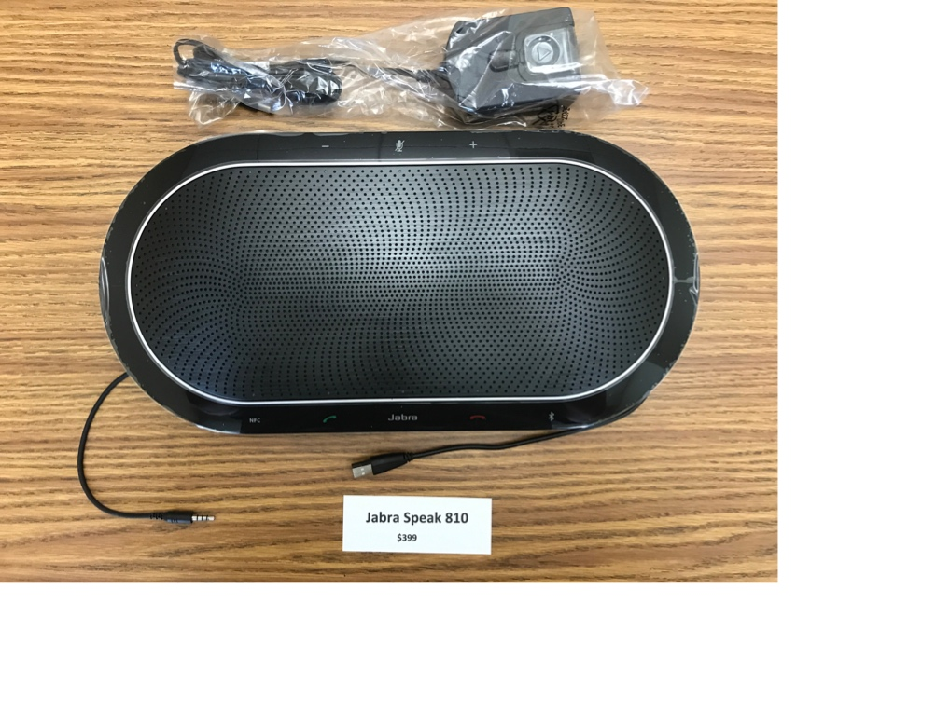
Equipment Choices:
Jabra Speak 810
Conference Phone Option 2
Cost: $399
Designed for use in larger rooms with larger groups of people
Recommended up to 15 people
USB or Bluetooth connectivity
Connect to PC, Smartphone or Tablet

Slide 18
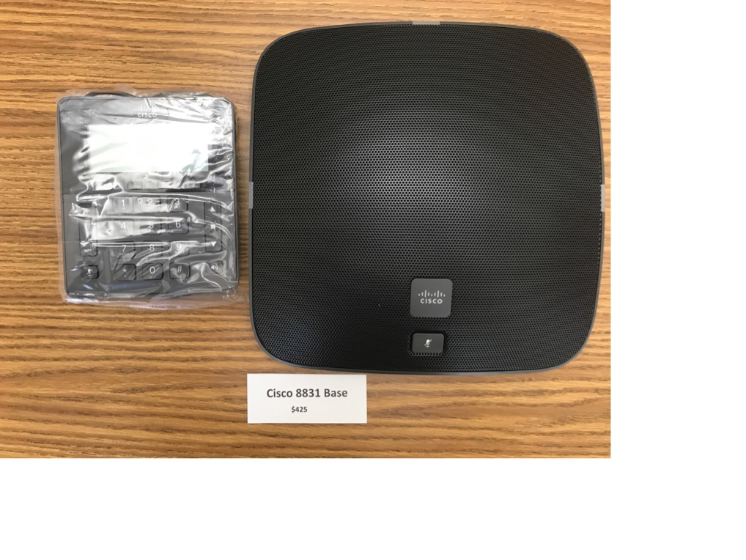
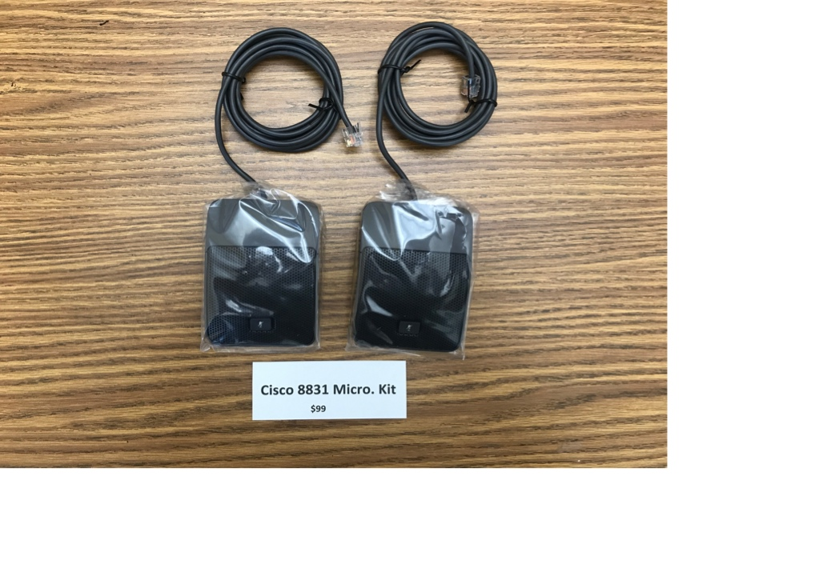
Cisco 8831 Base
Conference Phone Option 3
Equipment Choices:
Cost: $425
Designed for use in larger rooms with larger groups of people
Rooms up to 400 square feet
Unit has its own phone number
Does not require a PC, smartphone, or tablet
Cisco 8831 Micro. Kit
Conference Phone Option 3 Kit
Cost: $99
Designed for use with Cisco 8831 Base
Increases the room size to 680 square feet

Slide 19
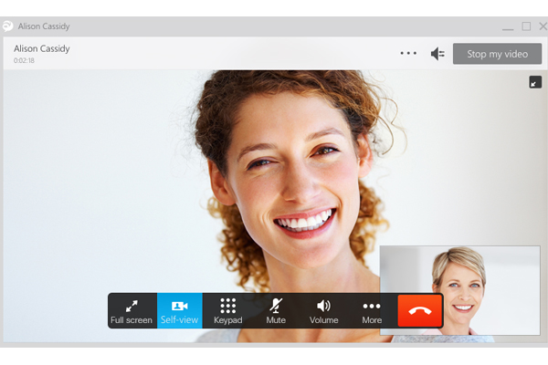
Jabber Client
Soft Phone Option
Full Unified Communications coming this fall (Chat, Presence, WebEx)
Works on Mac and PC (Mac features may not be on par with PC - yet)
No Cost for the ”soft” client

Slide 20
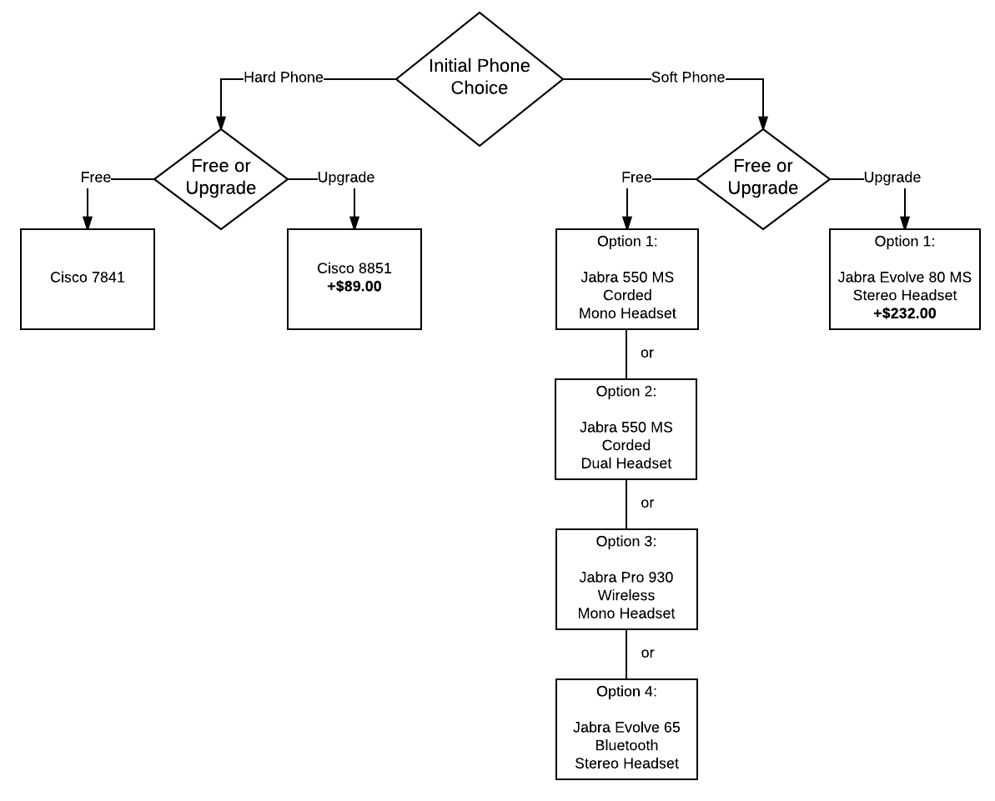
Phone Choice Flow Chart:

Slide 21
Key Changes
CENTREX (old) | CISCO VoIP (new)
5-digit dialing for on-campus calls 4-4357 (DoIT Help Desk) | 7-digit dialing for on-campus calls 264-4357 (DoIT Help Desk)
Dial 9 to make off-campus calls 9+257-9248 (Ian’s Pizza) | Dial 1 + 7-digit number to make a non-campus local call 1-257-9248 (Ian’s Pizza)
Dial 8 or 9 to make long-distance calls 8-1-999-867-5309 (♫“Jenny, I’ve Got Your Number” ♫) | Dial 1+ 1 + area code + 7 digit number to make a long-distance call 1-1-999-867-5309 (♫“Jenny, I’ve Got Your Number” ♫)
Notes:
Note changes to calling pattern for on-campus calls

Slide 22
Key Changes
CENTREX (old) | CISCO VoIP (new)
5-digit dialing for on-campus calls 4-4357 (DoIT Help Desk) | 7-digit dialing for on-campus calls 264-4357 (DoIT Help Desk)
Dial 9 to make off-campus calls 9+257-9248 (Ian’s Pizza) | Dial 1 + 7-digit number to make a non-campus local call 1-257-9248 (Ian’s Pizza)
Dial 8 or 9 to make long-distance calls 8-1-999-867-5309 (♫“Jenny, I’ve Got Your Number” ♫) | Dial 1+ 1 + area code + 7 digit number to make a long-distance call 1-1-999-867-5309 (♫“Jenny, I’ve Got Your Number” ♫)
Notes:
Note changes to calling pattern for off-campus calls

Slide 23
Key Changes
CENTREX (old) | CISCO VoIP (new)
5-digit dialing for on-campus calls 4-4357 (DoIT Help Desk) | 7-digit dialing for on-campus calls 264-4357 (DoIT Help Desk)
Dial 9 to make off-campus calls 9+257-9248 (Ian’s Pizza) | Dial 1 + 7-digit number to make a non-campus local call 1-257-9248 (Ian’s Pizza)
Dial 8 or 9 to make long-distance calls 8-1-999-867-5309 (♫“Jenny, I’ve Got Your Number” ♫) | Dial 1+ 1 + area code + 7 digit number to make a long-distance call 1-1-999-867-5309 (♫“Jenny, I’ve Got Your Number” ♫)
Notes:
Note changes to calling pattern for long-distance calls
Link to Tommy Tutone song, “Jenny ( 867-5309)”: https://www.youtube.com/watch?v=qc5u9NOV4sE

Slide 24
Key Changes (continued)
CENTREX (old) | CISCO VoIP (new)
Centrex phone was plugged into a phone jack in wall | VoIP phone is plugged into the network data jack using an Ethernet cable
Your existing phone number will not change with Cisco VoIP
Notes:
Data jacks are the orange-colored ones.
Data jack plugs into the phone; the phone plugs into the computer
No need to change your business cards for phone number or Dept website if phone numbers already published

Slide 25
Summary of Key Changes
CENTREX (old) | CISCO VoIP (new)
5-digit dialing for on-campus calls 4-4357 (DoIT Help Desk) | 7-digit dialing for on-campus calls 264-4357 (DoIT Help Desk)
Dial 9 to make off-campus calls 9+257-9248 (Ian’s Pizza) | Dial 1 + 7-digit number to make a non-campus local call 1-257-9248 (Ian’s Pizza)
Dial 8 or 9 to make long-distance calls 8-1-999-867-5309 (♫“Jenny, I’ve Got Your Number” ♫) | Dial 1+ 1 + area code + 7 digit number to make a long-distance call 1-1-999-867-5309 (♫“Jenny, I’ve Got Your Number” ♫)
Centrex phone was plugged into a phone jack in wall | VoIP phone is plugged into the network data jack using an Ethernet cable
Your existing phone number will not change with Cisco VoIP

Slide 26
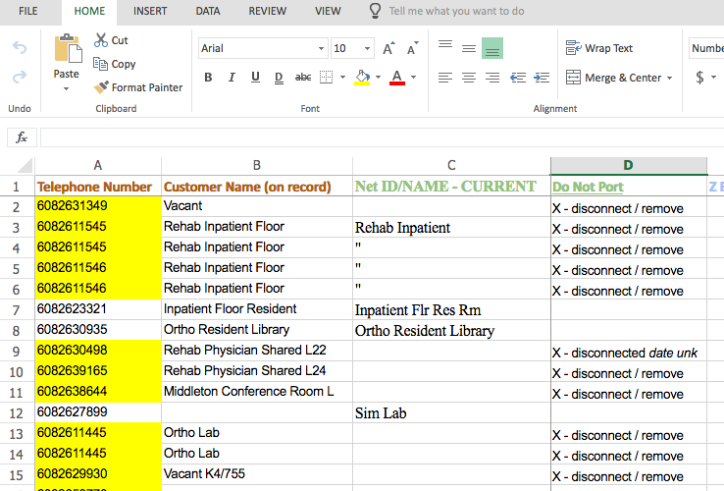
Transition Phase 1
Contact us (for now)
Generate a census
Schedule “Phase 1 Kickoff Meeting”
Go over any questions and/or unique uses/cases
Verify the phone numbers in the census and mark any numbers that are out-of-scope (up to 4 weeks)
Submit to campus for a transition date
**Once submitted to campus no changes can be made to numbers on the port sheet (there are a few exceptions)

Slide 27
Transition Phase 2
Get Transition date back from campus
Schedule ”Phase 2 Kickoff Meeting”
Go over any questions and/or unique uses/cases
Verify/document all the following:
  Names
  Net ID’s
  Locations
  Data Jack #’s
  Calling Restrictions
  Voicemail
  Calling process other than basic
  Flowcharting/documenting complex calling situations
Submit to campus about 5 weeks prior to your transition date

Slide 28
Transition Phase 3
Starts about 1 – 2 weeks prior to your transition night
You will need a place for the equipment to arrive that needs to be distributed
You will also need an office/space for DoIT to work out of that has live network jacks
DoIT will arrange and come on-site to install all the phones and distribute all the head sets (approximately 1 – 2 weeks prior to your transition night) at this time documentation will be left with the phones and headsets.
Your local IT Staff will need to install the soft client
DoIT will arrange to come on-site to provide training to staff (approximately 1 – 2 weeks prior to your transition night)
Transition of your phones starts at 5pm on the transition night and should be done by 6am the next day. That next day is your first day of service.
DoIT staff will be on site for the morning of your first day of service to do further testing and troubleshoot any issues that arrive.

Slide 29
Transition Key Points
AT&T needs 8 weeks minimum to set up the phone numbers in their system to be ported
Porting will typically be done on Monday Nights and Wednesday nights so the first day of service will be Tuesday and Thursday
Only 250 lines can be ported in a single night
Greetings will need to be recreated
Voicemail saved on the “old” system will remain there until that system is taken off-line

Slide 30
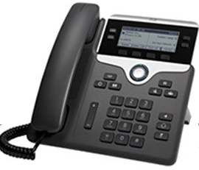

When Cisco VoIP goes live…
New Dialing Pattern
  7 digits for a campus call
  1 + 7 digits for a non-campus local call
  1 + 1 + area code + 7 digits for a long distance call
New Voicemail Box
  Old voicemail messages will not transfer to new system
  To download a copy of old voicemail message, refer to UW KnowledgeBase doc #17344, Voice Mail - Web PhoneManager Settings
  Set up Voicemail in Cisco VoIP (refer to UW KnowledgeBase doc 72618)
New Phone
  “Hard” phone (on your desk)
  “Soft” client is Cisco Jabber, an app on your computer (for Windows and Mac)
If you need to call 911 from your phone:
  If from campus on the UW wired/wireless network or you have a work-at-home agreement, your location can be determined
  If outside of campus network, identify your location to emergency services
Notes:
Remember new dialing pattern for placing calls. (Retrain muscle memory)
If you wish to keep your old voicemail message, download them from the UW-Madison Web PhoneManager before your “go live” date. URL is: voicemail.doit.wisc.edu
Web PhoneManager allows you to change your Playback Settings to download a copy of the voice mail message as a .wav audio format file to your computer.
Refer to KB doc #17344, “Voice Mail – Web PhoneManager Setup, section for Web PhoneManager Settings
KB doc for Cisco Jabber Overview (including links for navigation and answering/placing calls) is doc #72533.
Set Up your new Voicemail Box on Cisco VoIP
Elizabeth Curran has already accessed her voicemail on the Cisco website.

Slide 31

When Cisco VoIP goes live… (continued)
SWAP (Surplus with a Purpose)
  Bins will be onsite to dispose old phones
  Pick up is planned 2-3 days post go-live
First day of service assistance
  Contact service assistance by phone at 262-3570
Support going forward
  Refer to your departmental IT support staff
  Contact DoIT Help Desk by phone or email (264-4357, help@doit.wisc.edu)
Notes:
Remember new dialing pattern for placing calls. (Retrain muscle memory)
If you wish to keep your old voicemail message, download them from the UW-Madison Web PhoneManager before your “go live” date. URL is: voicemail.doit.wisc.edu
Web PhoneManager allows you to change your Playback Settings to download a copy of the voice mail message as a .wav audio format file to your computer.
Refer to KB doc #17344, “Voice Mail – Web PhoneManager Setup, section for Web PhoneManager Settings
KB doc for Cisco Jabber Overview (including links for navigation and answering/placing calls) is doc #72533.
Set Up your new Voicemail Box on Cisco VoIP
Elizabeth Curran has already accessed her voicemail on the Cisco website.

Slide 32
Resources and Documentation
KnowledgeBase at kb.wisc.edu/page.php?id=72125 or go.wisc.edu/3zy038
(search term, “Cisco VoIP” or document # “72125” )
Cisco VoIP handouts
Hard copy of phone Quick Reference Guides with delivery of equipment (includes link to online training videos)
Electronic version available on UW-Madison KnowledgeBase site
Cisco VoIP Project Website at https://voip.it.wisc.edu
Support Questions?
Refer to your departmental IT support staff
Contact DoIT Help Desk by phone or email (264-4357, help@doit.wisc.edu)
Notes:
UW-Madison KnowledgeBase is: https://kb.wisc.edu
DoIT Help Desk KnowledgeBase is: https://kb.wisc.edu/helpdesk/

Slide 33
Questions

Slide 34

THANK YOU.
Notes:
Thank you for being an early adopter…we appreciate it.
Your feedback and experiences will benefit all of us as we migrate to the new Cisco VoIP phone system.

